Slide 1
Pricetto Brand Guide
How we portray ourselves in-Market

Slide 2
Vision Statement
To become the most trusted, bright resource for helping people spend smarter — every day, in every category.
8-2-25

Slide 3
Mission Statement
We empower people to shop, spend, and save with confidence — through playful games, honest advice, and daily discoveries that make money feel less overwhelming and more fun.
8-2-25

Slide 4
Content Scope & Platform Expansion
🛍️ Daily Deals
Hand-picked, verified deals across retail & ecommerce
💳 Credit Cards
Offers, rewards programs, points hacks
🏦 Banking & Saving
High-yield accounts, fee-free banking options
🧾 Subscriptions
Best-value services, how to cancel & manage costs
💡 Consumer Education
Articles, guides, and explainers on spending psychology

Slide 5

Audience Persona
Pricetto’s brand is built for curious, value-conscious consumers who want to be smart — but still have fun.
Becca
Marketing Manager, side hustler, or creative
Pain Points
Overwhelmed by shopping discovery
Always loves a good deal
Wants to spend wisely but hates financial jargon
Goals
Save time and money
Discovery products worth buying
Feel confident, not stressed, about spending
Tone Resonates when
It’s smart, not smug
Playful, not silly
Honest, not salesy

Slide 6
Brand Voice
Pricetto is to be taken seriously, not too gimmicky
While we are leaning on gamification to start, we must present Subject Matter Expertise to obtain our end goal
Present as knowledgeable in consumerism, costs, and the economy
Seem like an advisor who brings great deals to consumers
Understand macro trends and be a commerce engine

Slide 7
Voice in Action
Pricetto’s voice is smart, friendly, and grounded in consumer advocacy. We speak clearly, never talk down, and add a wink of fun.
Website
Spend smarter. Play daily. Discover your next favorite thing
Daily Game copy
Can you sniff the savings? Let’s find a good price.
Social Post (Instagram)
I’m a guessing machine and got it in 3. Think you can beat that? #Pricetto
Newsletter Subject Line:
3 Secret deals you didn’t know exist, plus today’s game.
Affiliate Editorial:
This dress is just $24, but it looks like it’s $300. I couldn’t resist

Slide 8
Brand Voice, Games only
Game Moment Puns (Correct Guess / Win)
“Squealed the Deal!” 🏆
“You Nailed It, Snout Doubt!”
“Oink-credible Guess!”
“You’re a Hog for Savings!”
“This Little Piggy Guessed Right!”
“Pork-fect Price!”
“You Hammed It Up Right!”
“That’s Some Prime Swine Savvy!”
“You Brought Home the Bacon!”
“Sizzlin’ Guess, Pricer!”
“You’re the Truffle Sniffer of Deals!”

Slide 9
Typography
Primary Typeface: Poppins
Headlines
Font: Poppins Bold or Semibold
Size: 32-48pt
Case: Sentence case or Title Case
Most often Primary Teal
Body Text
Font: Poppins Regular
Size: 14-16pt
Line Spacing: 1.5x
Color: Charcoal or Off-white
Captions / Labels
Font: Poppins Medium or Semibold
Size: 12pt
Use sparingly for buttons or badges
Pricetto

Slide 10
Color Codes
0C4A6E
Name | HEX | Use Case | Role
Primary Teal | #086870 | Core accent, logo, buttons, icons | Brand Primary
Charcoal | #333333 | Primary Text | Text Base
Off-White | #FAFAFA | Backgrounds, cards, UI surfaces | UI Background
Success Mint | #3BB273 | Correct Guesses, positive actions | Success Feedback
Cautious Coral | #3B695B | Incorrect guesses, alerts | Error Feedback
Dusty Blue | #527B99 | Financial topic, overlays, secondary buttons | Accent - Trust
Soft Gold | #F3C76A | Category tags, seasonal flair | Accent - Highlight
Muted Lilac | #B9A8DA | Social titles, lifestyle topics, visual variety | Accent - Playful

Slide 11

Priscilla
She is sacred
She is to never be depicted doing anything illegal
She is fun but simple
She is straight faced and knowledgeable
She is always without a mouth and arms and always faces to the right
She can be utilized in various outfits and accessories, when tasteful

Slide 12
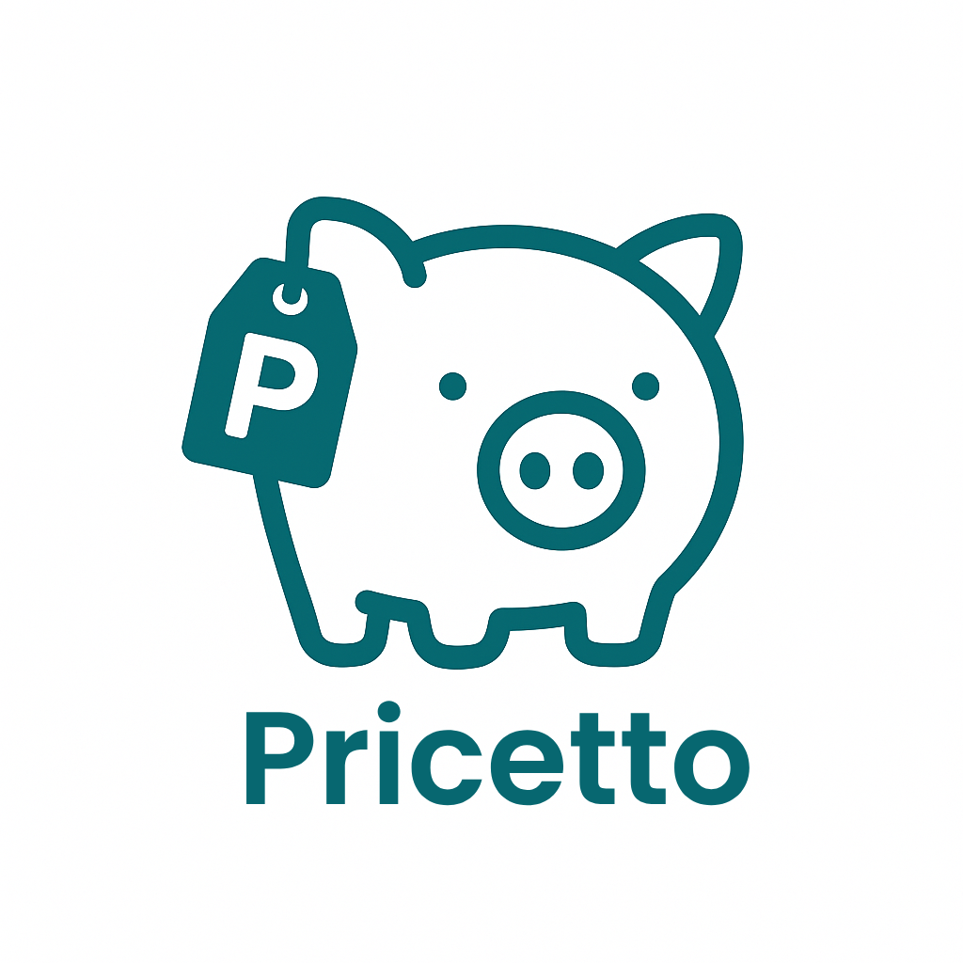

Logo Versions
On White Backgrounds
On Colorful Backgrounds
No Wordmark Used

Slide 13

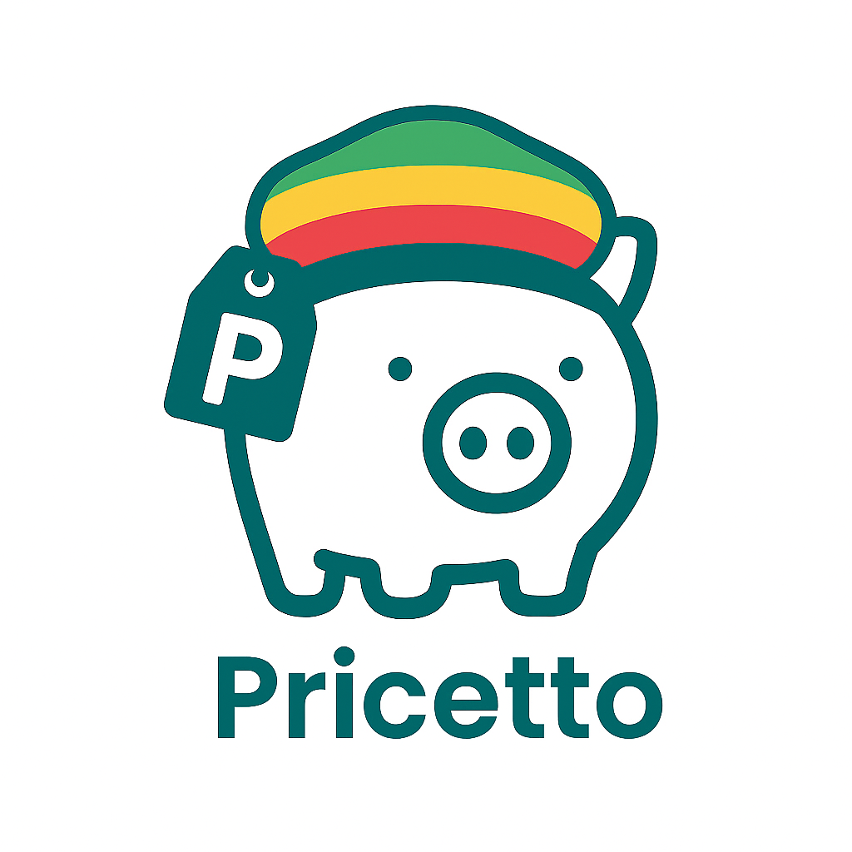
Priscilla Variants
Construction
Rast

